Slide 1
ET0023 Operating Systems
9. Virtual Memory

Slide 2
Virtual Memory
Definition:
A storage allocation scheme in which secondary memory can be addressed as though it were part of main memory.
Technique:
A program references memory using a virtual address.
The virtual address is translated automatically to the corresponding real memory address.
The size of virtual storage is limited by
the addressing scheme of the computer system, and
the amount of secondary memory available
not by the actual number of main storage locations.
Notes:
Win: Virtual Memory
Linux: swap space

Slide 3
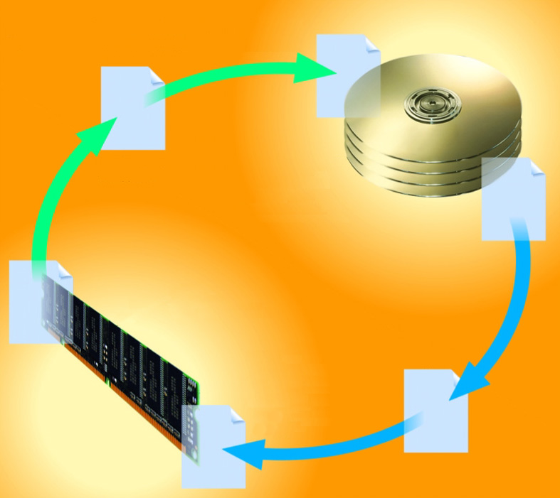
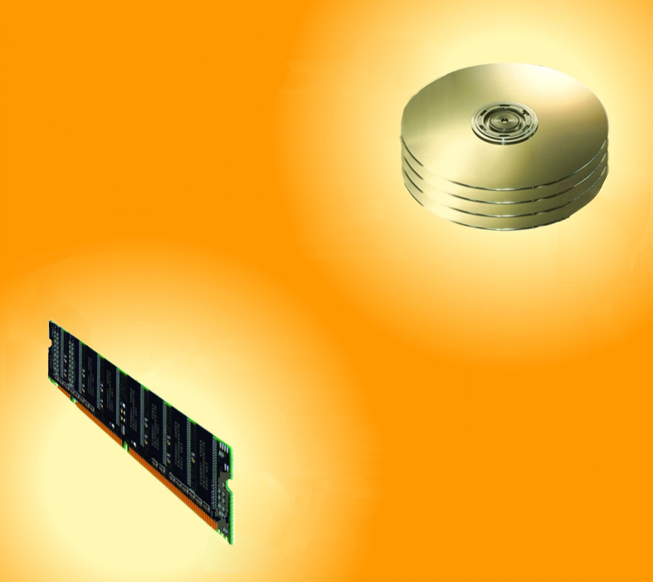
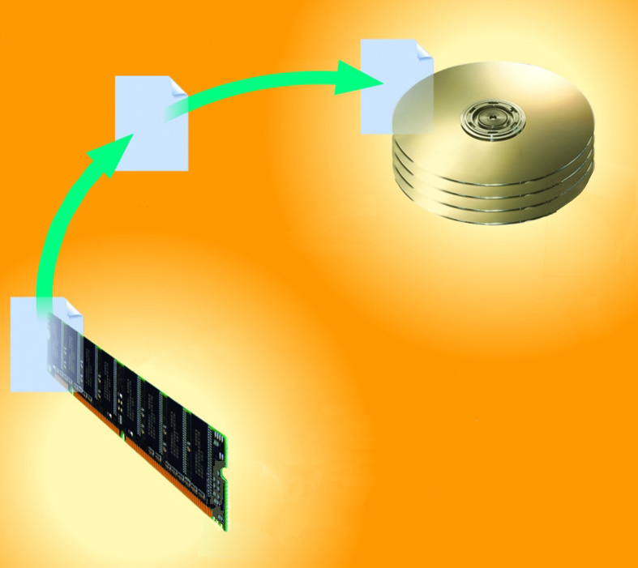
What is virtual memory (VM) management?
page swapped out
page swapped out
Operating system allocates portion of hard disk to function like RAM
Paging
disk (virtual memory)
disk (virtual memory)
disk (virtual memory)
RAM (physical memory)
RAM (physical memory)
RAM (physical memory)
page swapped in
page swapped in

Slide 4
Implementation
Each process has an illusion of a large address space e.g. 2³² (for 32-bit addressing) = 4 GB
But this illusion is also shared by multiple processes!
However, physical address space is much smaller e.g. 4 GB
So if we have 8 processes addressing 4GB each
total memory = 8 x 4 GB = 32 GB
But we have only 4 GB!!
Notes:
In Linux, the page size is usually 4 KB.
Each page in logical memory is mapped to a frame in the physical memory.
In 32-bit addressing, total physical memory = 4 GB. If page size = 4 KB, then total number of frames = 4 GB / 4 KB = 1 Million frames.

Slide 5
Implementation
Virtual memory space
Physical memory space
Page 0
Page 1
Page 2
Page 3
Page 4
Page 5
Page 6
Page 7
frame 0
frame 1
frame 2
frame 3
frame 4
frame 5
---
frame 20
Process 1
MMU
Secondary storage
pp12
pp1
pp3
pp5
pp20
pp22
pp25
Cache hit
---
frame 22
---
frame 25
---
frameMM
Cache miss
Page 21
Page 22
Page 23
Page 24
Page 25
Page 26
Process 2
Translation Page Table
Virtual memory (swap space)
Pages are swapped out (cache miss)
RAM
Notes:
The memory management unit (MMU) provides the translation table for logical to physical addresses mapping.
In the example above
Process 1: page 1 is mapped to frame 1; page 2 is mapped to frame 3; page 3 is mapped to frame 5.
Process 1: page 4, page 5 and page 7 are stored as virtual memory in HDD.
Process 2: page 21 is mapped to frame 25; page 25 is mapped to frame 22.
Process 2: page 22, page 23 and page 24 are stored as virtual memory in HDD.

Slide 6
Advantages of Virtual Memory
Separates user's logical memory from physical memory.
Only part of the program needs to be in physical memory for execution
Logical address space can therefore be much larger than physical address space
Allows physical address spaces to be shared by several concurrent processes
Allows for more efficient process creation

Slide 7
Swapping vs Paging
Swapping | Paging
Loads entire process in memory: runs it, exit Is slow (for big, long-lived processes) Wasteful (might not require everything) | Runs all processes concurrently, taking only pieces of memory (pages) away from each process Finer granularity, higher performance Paging completes separation between logical memory and physical memory – large virtual memory can be provided on a smaller physical memory

Slide 8
How does VM work?
Modify Page Tables with another bit (“is present”)
If page in memory, is_present = 1, else is_present = 0
If page is in memory, translation works as before
If page is NOT in memory, translation causes a page fault
page | location | IP
Pg000 | 1273 | 1
Pg001 | 443 | 0
pg002 | 177 | 0
pg003 | 3000 | 1
Memory
Disk

Slide 9
How to handle Page Faults
On a page fault:
OS finds a free frame, or evicts one from memory
Which one?
Want knowledge of the future?
Issues disk request to fetch data for page
What to fetch?
Just the requested page, or more?
Block current process, context switch to new process
How?
Process might be executing an instruction
When disk completes, set is_present bit to 1, and current process in ready queue

Slide 10
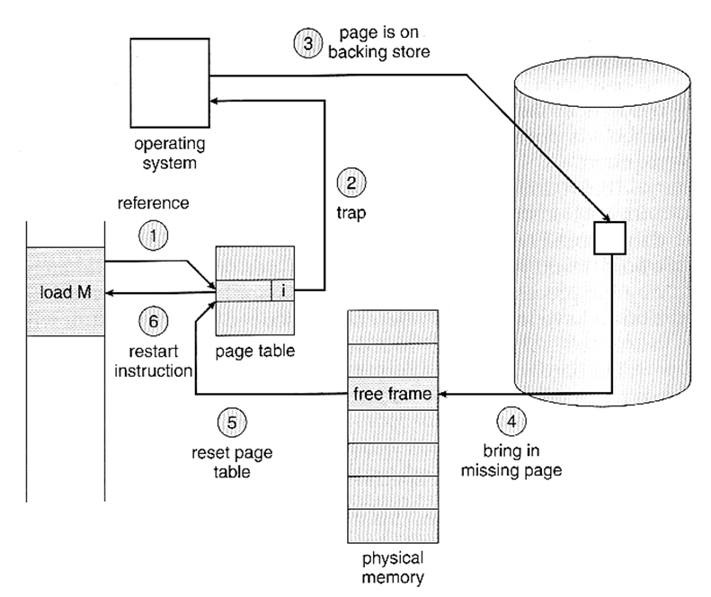
Steps in handling a Page Fault

Slide 11
What to replace (who to evict)?
What happens if there is no free frame?
Find a suitable page in memory, swap it out
Page Replacement
When process has used up all frames it is allowed to use
OS must select a page to eject from memory to allow new page
The page to eject is selected using the Page Replacement Algorithm
Goal: Select page that minimizes future page faults

Slide 12
Tip: Modify/Dirty Bits
Evict pages that have not been changed!
Use modify (dirty) bit to reduce overhead of page transfers
Only modified pages are written to disk. Writing has high overheads.
Process text segments are rarely modified, can bring pages back from the program image stored on disk

Slide 13
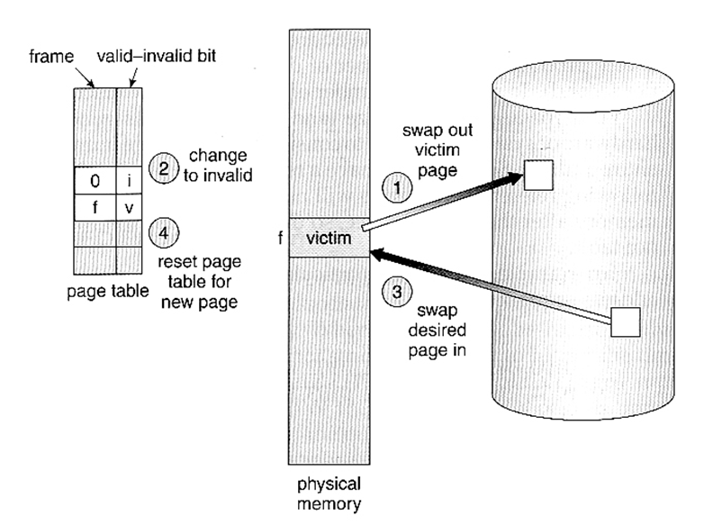
Page Replacement

Slide 14
Page Replacement Algorithms
• Random | Pick any page to eject. Used for comparison.
• FIFO | The page brought in earliest is evicted Ignores usage.
• OPT | Belady’s algorithm Select page not used for longest time
• LRU | Evict page that hasn’t been used the longest. Past could be a good predictor of the future
• MRU | Evict the most recently used page
• LFU | Evict least frequently used page

Slide 15
First-In-First-Out Replacement
Assume pages are accessed in the following order: 1, 2, 3, 4, 1, 2, 5, 1, 2, 3, 4, 5
We only have 3 frames in memory per process
How many page faults?
1
2
3
2
3
4
3
4
1
4
1
2
1
2
5
1
2
5
1
2
5
2
5
3
5
3
4
5
3
4
9 Page faults
3
4
5
6
7
nc
nc
8
9
nc

Slide 16
First-In-First-Out Replacement
Assume pages are accessed in the following order: 1, 2, 3, 4, 1, 2, 5, 1, 2, 3, 4, 5
We only have 4 frames in memory per process
How many page faults?
3
4
5
1
4
5
1
2
5
1
2
3
10 Page
faults
1
2
3
4
1
2
3
4
1
2
3
4
1
2
3
4
2
3
4
5
2
3
4
5
4
nc
nc
5

Slide 17
Optimal Algorithm
Replace page that will not be used for longest period of time
How do we know which frame?
Used for measuring how well your algorithm performs
Eg: 4 frames, Seq: 1, 2, 3, 4, 1, 2, 5, 1, 2, 3, 4, 5
Result: 6 Page faults

Slide 18
Optimal Approximation
In real life, we do not have access to the future page request stream of a program
No way to know definitively which pages a program will access
So we need to make a best guess at which pages will not be used for the longest time

Slide 19
Least Recently Used Algorithm
Implemented with a Counter.
Every page entry has a counter; every time page is referenced through this entry, copy the clock into the counter
When a page needs to be changed, look at the counters to determine which are to change
Eg: 4 frames, Seq: 1, 2, 3, 4, 1, 2, 5, 1, 2, 3, 4, 5
8 Page
faults
1
2
3
4
2
3
4
1
3
4
1
2
4
1
2
5
4
2
5
1
4
5
1
2
5
1
2
3
1
2
3
4
2
3
4
5
4
nc
nc
5
nc
nc
6
7
8

Slide 20
Implementing Perfect LRU
On reference – timestamp the page
On eviction – scan for oldest frame
Problems:
Large page lists (scanning is slow)
Timestamps are costly (software/implementation)
Possible solutions
Clock Algorithm (FIFO + reference bit), low accuracy
Clock Algorithm with another hand – Leading edge clears reference bits, trailing edge evicts pages

Slide 21
Other Algorithms
MRU (Most Recently Used)
Works well for data that is accessed only once
Not good fit for other data
LFU (Lowest Frequently Used)
Remove pages with lowest count
No timestamp, just a counter (shift right by 1)
MFU (Most Frequently Used)
Not a good algorithm

Slide 22
Allocating Pages to Processes
Global replacement
Single memory pool for the entire system
On page fault, evict oldest page in system
Problem: Lack of performance isolation
Local (per-process) replacement
Have separate pool of pages for each process
Page fault in one process, can only replace pages from its own process
Problem: May have idle resources

Slide 23
Thrashing
Definition: Excessive rate of paging
Lack of resources
Caused by bad choices of the eviction algorithm
Keep throwing out page that will be referenced soon
Swap-in and Swap-out of pages
Causes
Poor locality, present requirements does not suit future processing
There is reuse, but process does not fit model
Too many processes in the system

Slide 24
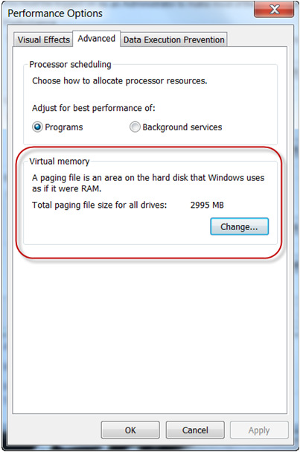
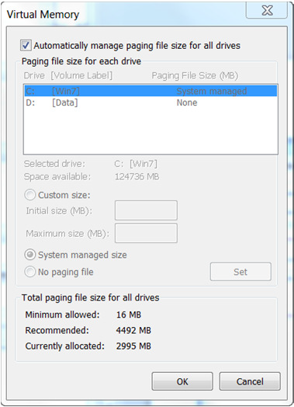
Windows

Slide 25
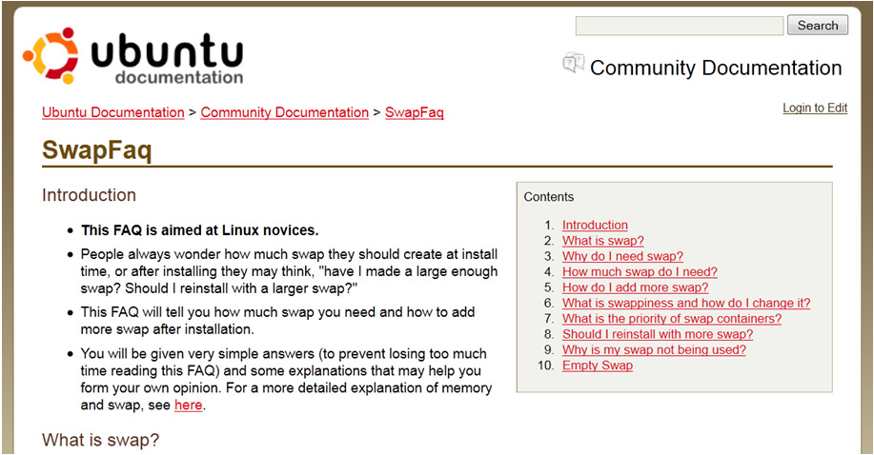
Linux
Swap Space
Read: https://help.ubuntu.com/community/SwapFaq

Slide 26
QUESTIONS

Slide 27
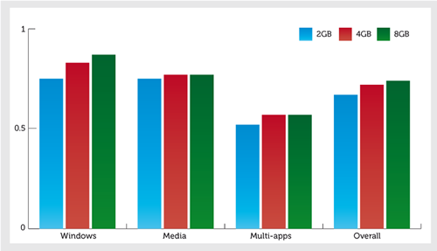
How much memory is enough?
http://www.pcauthority.com.au/Feature/375815,how-to-how-much-ram-do--you-really-need.aspx
Notes:
With only 2GB onboard, Windows had to make regular use of virtual memory; going up to 4GB let it keep everything in memory, bringing a performance increase of 11%; and adding a further 4GB provided extra headroom for SuperFetch, which delivered an additional 5% boost. In the Multi-apps test, things were less clear-cut. Moving up from 2GB to 4GB gave us a similar speed improvement of 10%, but adding RAM beyond this point didn’t help, presumably because the system wasn’t idle for long enough to allow SuperFetch to do its thing.
In our Media exercises, which rely on number-crunching rather than file access, adding memory had almost no effect on performance.
Overall, the difference between a 4GB system and an 8GB one was only 3%. You might consider that significant enough to justify an upgrade, but it’s nowhere near as transformative as you might expect.
Read more: http://www.pcauthority.com.au/Feature/375815,how-to-how-much-ram-do--you-really-need.aspx#ixzz3I9dYpGm1

